Slide 1
Robot Vision Course Project
The Overfitters
Alejandro Sanchez (aas10269)
Dmitri Lyalikov (NetID2)
Vaibhav Choudhary (vc2640)
Jean-Pierre Troin (NetID3)

Slide 2
Description of the Problem and References
Problem Statement: The task is to design a vision-based autonomous navigation system that can move a robot from the start point to the goal point in a simulated maze environment using the vis_nav_player simulator. The robot must use the provided exploration data and visual feedback to navigate accurately(autonomously) without human control.
Objectives:
Reach the target goal position with minimum error.
Implement and apply learnt concepts from Robotics Perception.
Minimize the total navigation time to under ten minutes.
Demonstrate understanding of robot perception and navigation concepts.
Implement and test the baseline navigation algorithm (baseline.py).

Slide 3
Tools & References:
vis_nav_player simulator repository from GitHub and baseline.py for navigation testing
Python (NumPy, Matplotlib, JSON, OpenCV, sklearn, logging) for data handling, image processing , logging and data analysis
Exploration data and startup.json provided for the competition
Concepts from Robot Perception lectures on visual odometry, feature extraction on images and path planning.
Research Papers:
David G. Lowe, “Distinctive Image Features from Scale-Invariant Keypoints, ”Computer Science Department, University of British Columbia, Vancouver, B.C. Canada
H. Jégou, M. Douze, C. Schmid and P. Pérez, "Aggregating local descriptors into a compact image representation," 2010 IEEE Computer Society Conference on Computer Vision and Pattern Recognition, San Francisco, CA, USA, 2010, pp.
Joe Yue-Hei Ng, Fan Yang, Larry S. Davis, “Exploiting Local Features from Deep Networks for Image Retrieval,” University of Maryland, College Park, MD
Liang Zheng, Yi Yang and Qi Tian, “SIFT Meets CNN: A Decade Survey of Instance Retrieval,” IEEE Transactions on Patterns Analysis and Machine Intelligence.
Shridhar H, Sunil Harakannanavar, Chetan R, Vidyashree Kanabur, Jayalaxmi H, Prashanth C R, “Optimized Image Mosaicing using ORB with Histogram Equalization for Real-Time Applications,” IEEE
Lu Wang, Zhiming Qiu, “Combining Color Histogram and ORB Features for Robust Visual Tracking,” School of Computer Engineering and Science, Shanghai University, Shanghai, China.

Slide 4
Methodology Summary Two Paths
Implemented two navigation methods:
  Baseline _lv1: classical SIFT + VLAD visual navigation with manual control.
  Full_Auto (Baseline++): hybrid ORB + Color Histogram features with adaptive graph weighting and heuristic A* planning (being worked on).
Built a K-NN navigation graph using blended edge weights (0.8 × VLAD + 0.2 × Color).
Used Heuristic A* with neighbor-voting for smoother and shorter paths.
Full Auto enabled semi- to fully-autonomous navigation with higher stability and lower computation time.

Slide 5
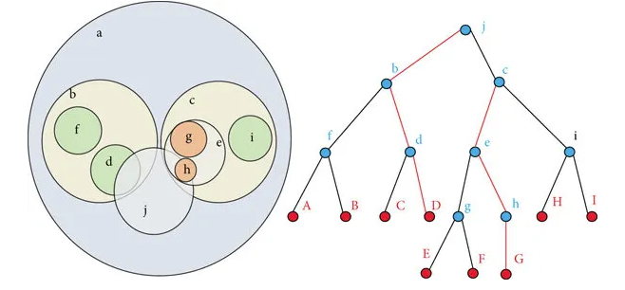
Methodology 1– SIFT->Kmeans->
VLAD->BallTree ->PathFinding
Feature Extraction: Compute SIFT descriptors for all exploration Images
Codebook Generation: Train a K-Means model to form visual vocabulary
VLAD Encoding: Aggregate local SIFT residuals against their cluster's centroids, producing compact per-image vector.
Database & Graph Construction: Store all VLAD vectors and connect each image to its 10 nearest neighbors to form a KNN weighted graph.
Navigation Phase:
Compute VLAD descriptor for the current first-person view(FPV).
Find the nearest pre-exploration image using a BallTree search.
Use A* on the KNN graph to plan the shortest path from current -> goal image.
Display the next best view for manual control and goal alignment.

Slide 6
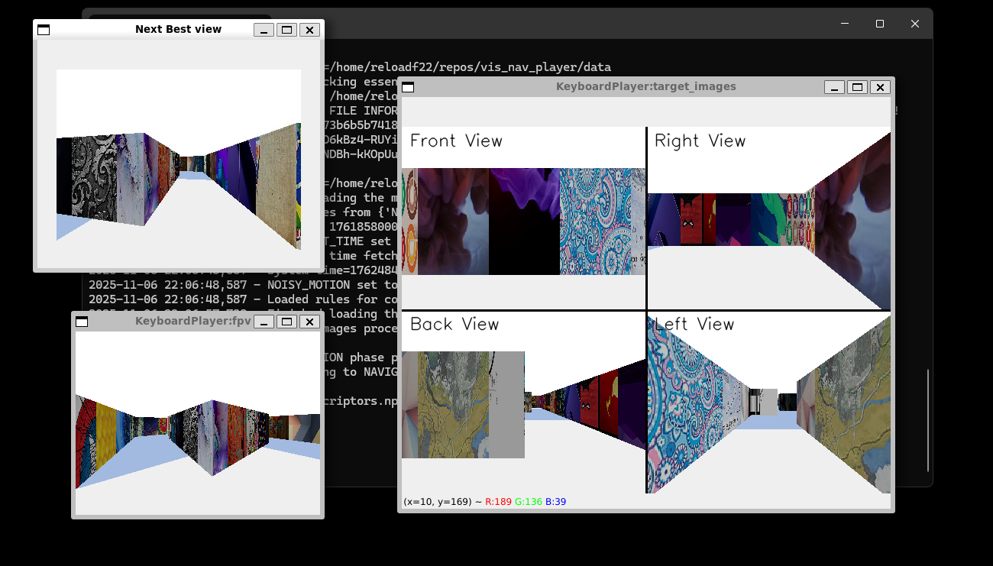
Methodology 1:
Here is a screenshot of how the methodology 1 used during the midterm simulation worked showcasing the “next best view” which gives us a clear trajectory about what path to take

Slide 7
Results
The system successfully reached the goal autonomously without manual input.
Successfully reached end of maze using “next best views” under 10 minutes. This step had to be done manually hence autonomous way was not working as it should. But the SIFT-VLAD encoding method successfully predicted a heuristic A* plan path for the user to follow.

Slide 8
Discussion and Conclusion
Conclusion:
The manual pipeline successfully demonstrated that it was able to show the user the path to reach the end of the maze.
Current manual approach shows strong potential for simulated maze traversal, but too slow for real world autonomous navigation.
Future on implementing autonomous path planning and navigation using (VLAD) and color-based features is being worked on, and we hope it will improve goal-reaching performance.

